Slide 1
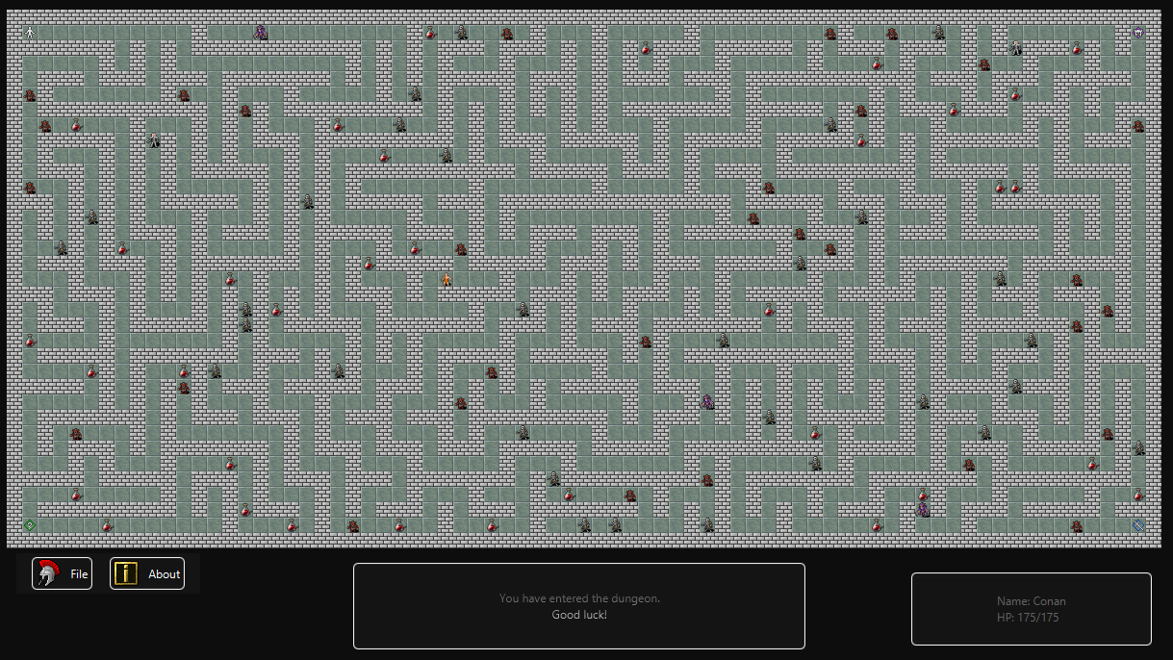
Dungeon Delver
Group: Benjamin Goodman, Christopher Nichol, Komisi Petelo

Slide 2
Description
Dungeon Delver is a Java and JavaFX based game with SQLite integration.
It has mechanics based upon the roguelike genre of games.
To win the game, battle monsters, sip potions and poisons, and collect the sacred Pillars of Object Oriented Programming, located in the four corners of the dungeon.
Controls: Arrow keys to move, Z to interact with the current space if it is interactable (potions and pillars).

Slide 3
Live Demo

